Slide 1

ECOX5004 Economic Policy Analysis & Evaluation
Assessing the impact of education on GDP output per capita across European nations
Jack O’Callaghan
Notes:
Hi, and welcome to the video. I’ll be taking you through the results of my initial modelling, and discussing next steps for this project.

Slide 2
To Recap, My Question is:
Does an increase in the average number of years of education lead to an increase in a country’s per-capita output-side real GDP in US Dollars?
This question is crucial to policymakers when appraising the economic impact of education policy options, for example potential regulatory changes to the minimum number of years citizens must spend in full-time education.
I have two main variables. My X (policy) variable is average number of years of education and my Y (impact) variable is per-capita output-side real GDP.
My dataset joins data from World Bank, Barro & Lee, and Penn World Tables.
Notes:
My project is on the topic of education. More specifically, the question my project aims to answer is if an increase in the average number of years of education leads to an increase in GDP output per capita. I chose this question as I wanted to contribute to the economic appraisal of education policy and progress the evidence base on how the impact of an additional year of education might vary by country.
My main two variables are the average number of years of education (which is my policy variable) and GDP output per-capita (which is my impact or dependent variable). I use data from a variety of economic and education-specific data sources, including World Bank, Barro & Lee, and Penn World Tables. My analysis focusses on the 27 EU member states, as well as the United Kingdom.

Slide 3
Variable Definitions
Variable | Description | Units | Source
rgdpo.pop | Real GDP Output per Capita | 2017 US$ | Penn World Tables 10.01
log.rgdpo.pop | Natural log of real GDP output per capita | 2017 US$ | Penn World Tables 10.01
year_orig | Years since 1970 | Years | Penn World Tables 10.01
yrs_sch | Average number of years of education | Years | Barro & Lee
voc | Share of all students in secondary education enrolled in vocational programmes (binary: above EU average 0/1) | Numerical Factor | World Bank
gen | Gender ratio for average years of schooling (binary: above European average 0/1) | Numerical Factor | Barro & Lee
avh | Average annual hours worked by persons engaged (employed) | Hours | Penn World Tables 10.01
csh_x | Share of merchandise exports at current PPPs | Numerical Factor | Penn World Tables 10.01
fdi | Foreign Direct Investment (FDI), net inflows as a share of GDP | % of GDP | World Bank
ctfp | TFP level at current PPPs (USA=1) | Numerical Factor | Penn World Tables 10.01
Notes:
I won’t linger on this slide for too long, but just as a reference point, these are the variables that I was able to gather data on from this analysis. Some of the core variables include: rgdpo.pop, which is real GDP output divided by a country’s population; yrs_sch, which is the average number of years a citizen will be enrolled in full-time education in a particular country; and voc, which measures if a country’s share of students involved in vocational programmes is above or below the EU average.

Slide 4
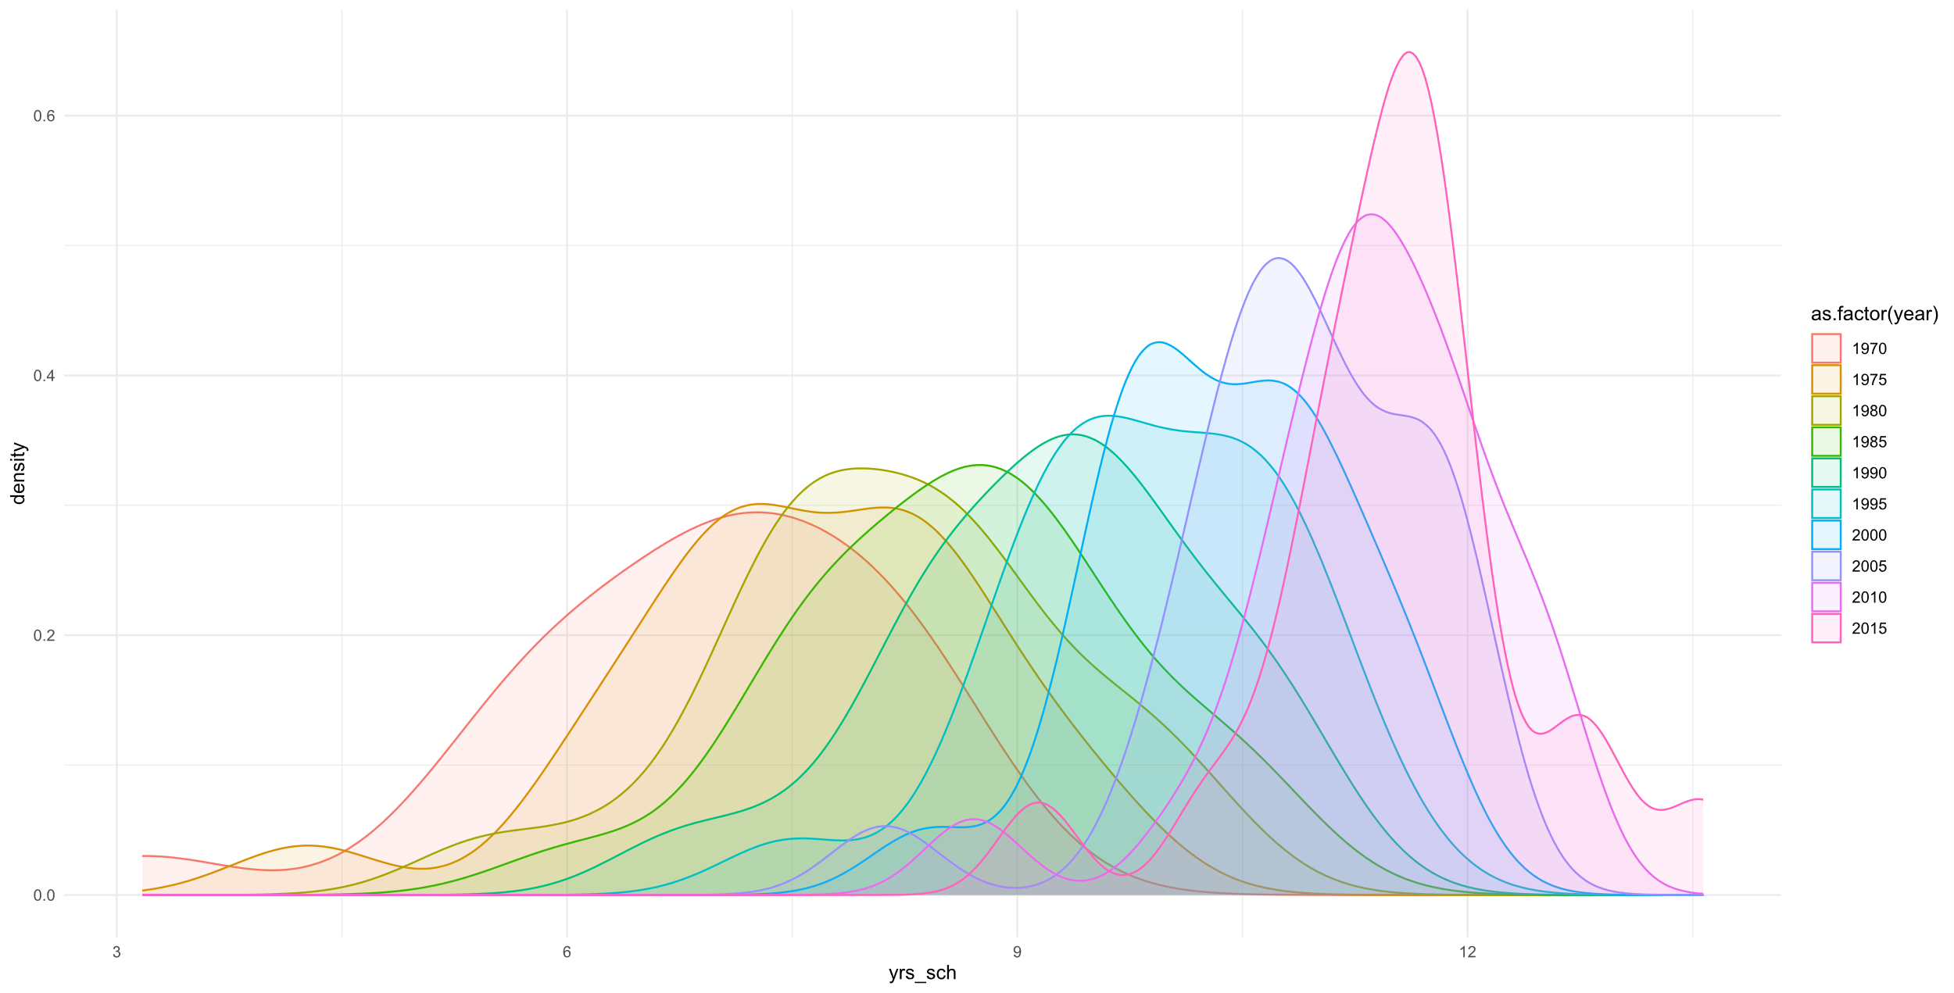
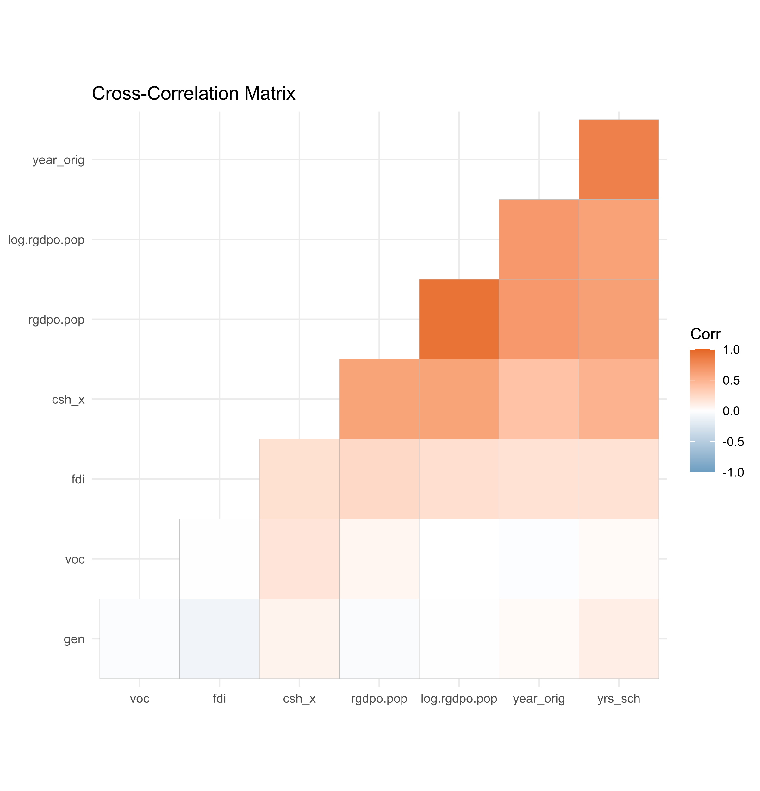
Summary stats for the data used
Looking first at the density plot, we can see that years of education has a single modal value for most years. The data also seems to be becoming more leptokurtic over time, implying that while years in education has been increasing over time, the difference in this figure between different countries has also been decreasing. The yrs_sch variable is slightly negatively skewed, but near symmetrical (-0.443).
As one might expect, real GDP output per capita and the log-transformed version are highly correlated.
Both versions of the real GDP output per capita variable are highly correlated with both number of years since 1970 (year_orig) and years of education (yrs_sch).
Variable | Count | Minimum | 1st Q. | Median | Mean | 3rd Q. | Maximum | Standard Deviation | Kurtosis | Skew
rgdpo.pop | 210 | 3,002 | 15,534 | 23,531 | 25,538 | 33,447 | 82,382 | 14,031 | 1.513 | 1.020
log.rgdpo.pop | 210 | 8.01 | 9.65 | 10.07 | 9.99 | 10.42 | 11.32 | 0.60 | 0.258 | -0.578
yrs_sch | 210 | 3.17 | 8.16 | 9.64 | 9.45 | 10.93 | 13.57 | 1.84 | -0.182 | -0.443
avh | 183 | 1,401 | 1,627 | 1,766 | 1,778 | 1,903 | 2,334 | 207.67 | -0.578 | 0.257
csh_x | 210 | 0.00 | 0.16 | 0.27 | 0.34 | 0.49 | 1.22 | 0.24 | 1.297 | 1.163
fdi | 210 | -15.71 | 0.58 | 1.95 | 10.36 | 5.39 | 340.26 | 31.16 | 62.452 | 6.820
ctfp | 207 | 0.45 | 0.76 | 0.87 | 0.88 | 0.98 | 1.44 | 0.18 | 0.562 | 0.308
Notes:
Okay, and now I’ll quickly cover some of the more numerical aspects of this project. Starting with the summary statistics table, you can see that for the 21 of 28 countries without major data gaps, there are no data gaps for 5 of the variables. Ctfp is missing just 3 observations, and avh a slightly more significant 27 observations, representing 87% variable coverage.
When it comes to the density plot of years of schooling over time, the mode years of schooling has been increasing consistently over each 5-year period in the data. The data has also become more leptokurtic, which could imply a standardisation in the number of years of education across the EU countries included in this analysis. The variable is close to symmetrical but has a slight negative skew. There is high correlation between real GDP output per capita and both time and years of education.

Slide 5
Results from your first estimation
rgdpo.pop = const + B1·year_orig + B2·yrs_sch + B3·voc
rgdpo.pop = const + B1·year_orig + B2·yrs_sch + B3·voc + B4·ctfp
 | Coefficient (M1) |  | Coefficient (M2)
const | −26984.10 | *** | −934.22
year_orig | 463.97 | *** | 507.57 | ***
yrs_sch | 1572.45 | *** | 1488.12 | **
voc | 1606.11 |  | 1973.48
ctfp | 30130.70 | ***
Model | R² Value | Adj. R² Value | Durbin-Watson | Durbin Lower (5%) | Durbin Upper (5%) | White’s Test
Model 1 | 0.482 | 0.475 | 1.636 | 1.61 (k=4) | 1.74 (k=4) | 0.000013
Model 2 | 0.621 | 0.614 | 1.702 | 1.59 (k=5) | 1.76 (k=5) | 0.000000
Notes:
And now I’ll move the results of the first two models. Both models were produced using Pooled OLS in Gretl, and I’ve rounded coefficients to 2.d.p to aid interpretation.
Model 1 regresses GDP output per capita against years since 1970, number of years of education, and the qualitative type of education offered in a country. Model 2 then builds on this by attempting to control for changes to Total Factor Productivity. I won’t linger on this slide, however, as the next slide contains more of a summary of the key findings.

Slide 6
Discussion of your results
Model 1 adjusted R² = 0.475; Model 2 adjusted R² = 0.614. Both models explain a high proportion of rgdpo.pop’s variance, and initial model specification is likely broadly sensible.
All predictors are significant at a 10% sig. level except voc (prevalence of vocational education), with p-values between 0.16 and 0.19. It may still be useful to include voc to control for qualitative differences in education.
Model 1 links years of education to GDP per capita, controlling for differences in education type (voc) and changes in productivity over time (indirectly with year_orig). Model 2 adds the productivity variable ctfp, which increases the adjusted R²/model p-value, and slightly changes model coefficients, but all coefficients remains within one standard deviation of their original estimates.
Durbin-Watson stat. in zone of indecision, but close to lower bound, so insufficient evidence of autocorrelation. Given the limited sample size for each country, it lagged variables might have been impractical regardless.
For White’s test for heteroscedasticity, both models had p-values < 0.01. We reject H₀ as there is evidence of heteroscedasticity in the data. We will consider transformations to rgdpo.pop to improve model fit.
Pooled OLS does not account for country or time-specific effects. The marginal return of one year of education might vary due to factors such as the current number of years of education and type of educational training.
Data gaps mean that this analysis only comprises of 21 countries, as opposed to the 28 planned. This reduces the generalisability of the results shown.
N.B. We ignore model constants when discussing statistical significance of predictor variables.
Notes:
Model 1 has an adjusted R² of 0.475, and Model 2 an adjusted R² of 0.614. This is a relatively strong model fit given that we used just 3 and 4 predictor variables respectively, which is quite a good R² for real-world data, and suggests that the overall model specification chosen represents a good starting point for these models. Also, all our predictors were statistically significant at the 10% significance level, except for voc. Voc had p-values between 0.16 and 0.19 across both models, however, and so may still be a useful control variable to keep in these models. We can also see that the addition of the total factor productivity variable in Model 2 had a strong positive impact on both the model’s overall p-value and adjusted R², and did not change the coefficient estimates too significantly, as all are still within 1 SD of the original.
I was not quite able to find statistically significant evidence of autocorrelation, but also was not able to not reject H0. For now, we will likely not progress with lagging the outcome variable. We found evidence of heteroscedasticity in the data and will examine options such as log-transforming the GDP output per capita variable to resolve this. Finally, we will also test alternative modelling approaches such as Fixed Effects modelling to see if this can improve the reliability of the estimates shown (…)

Slide 7
Your plan for the next steps
Upon inspection of initial modelling, there were a few key problems to address. Firstly, we found evidence that heteroscedasticity is present in the data. We will attempt to resolve this by log-transforming our Y (impact) variable to account for possibly diminishing marginal returns to scale to an additional year of education as education increases.
There are some questions left unresolved relating to model structure. Given the panel structure of this data and the differences in initial GDP output per capita, it might be the case that a Fixed Effects model might be more appropriate than the initial pooled OLS approach. We will build an equivalent Fixed Effects model and use the Hausmann and Breusch-Pagan LM tests to examine the appropriateness of a Fixed Effects model for this data.
The parameter estimates for ctfp in Model 2 do not tell us very much, as this variable has a range of 0.99 and increases GDP by $30,100 per unit increase. We will add average hours worked as an instrumental variable, in hope of reducing the scale of this estimate. However, an alternative predictor might be a useful addition in future.

Slide 8
Suggestions for future work
The biggest challenge with my analysis to date relates to data gaps. This has forced me to choose between variable imputation where the number of gaps is very small or narrowing the scope of the analysis.
It is possible that with more research and time to arrange access permissions, I would have been able to source alternative or estimated data, reducing the need to exclude countries. This would likely improve the generalisability of the findings of this analysis.
The ctfp variable is difficult to interpret, as it measures total factor productivity as a decimal between 0.45 and 1.44 (relative to the US). Given the size of this coefficient, a Fixed-Effects model might be more appropriate, as for a Pooled OLS model this coefficient dominates Model 2.

